Slide 1
CSC410 - Professional Practices in IT
Instructor Name : Sidra Nasir

Slide 2
Today Topics
Act Utilitarianism
Rule Utilitarianism
Social Contract Theory

Slide 3
Act Utilitarianism

Slide 4
Principle of Utility
Jeremy Bentham and John Stuart Mill
An action is good if its benefits exceeds its harms
An action is bad if its harms exceed its benefits
Utility: tendency of an object to produce happiness or prevent unhappiness for an individual or a community Happiness = advantage = benefit = good = pleasure
Unhappiness = disadvantage = cost = evil = pain

Slide 5
Principle of Utility (Greatest Happiness Principle)
An action is right (or wrong) to the extent that it increases (or decreases) the total happiness of the affected parties.

Slide 6
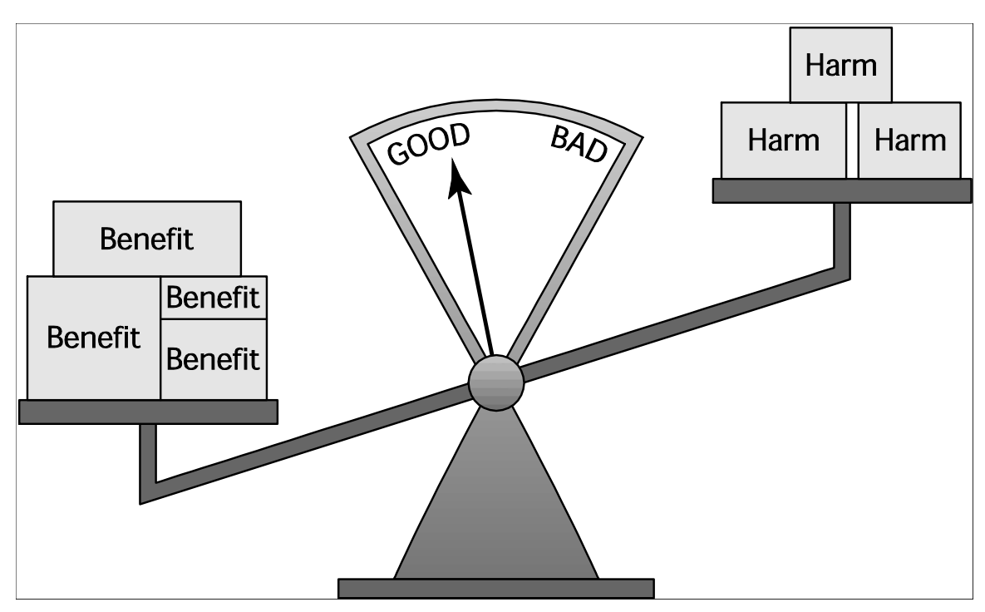
Principle of Utility

Slide 7
Act Utilitarianism
Utilitarianism
– Morality of an action has nothing to do with intent
– Focuses on the consequences
– A consequentialist theory
• Act utilitarianism
– Add up change in happiness of all affected beings
– Sum > 0, action is good
– Sum < 0, action is bad
– Right action to take: one that maximizes the sum

Slide 8
Bentham: Weighing Pleasure/Pain
Not all benefits have equal weight. To measure them, he proposed seven attributes that can be used to increase or decrease the weight of a particular pleasure or pain:

Slide 9
Bentham: Weighing Pleasure/Pain
Intensity: magnitude of the experience
Duration: how long the experience lasts
Certainty: probability it will actually happen
Propinquity: how close the experience is in space and time
Fecundity: its ability to produce more experiences of the same kind
Purity: extent to which pleasure is not diluted by pain or vice versa
Extent: number of people affected

Slide 10
Evaluating a Scenario Using Act Utilitarianism
A state is considering replacing a curvy stretch of highway that passes along the outskirts of a large city. Would building the highway be a good action?

Slide 11
Highway Routing Scenario
State may replace a curvy stretch of highway
New highway segment 1 mile shorter
150 houses would have to be removed
Some wildlife habitat would be destroyed

Slide 12
Evaluation
Costs
– $20 million to compensate homeowners
– $10 million to construct new highway
– Lost wildlife habitat worth $1 million
Benefits – $39 million savings in automobile driving costs
Conclusion
– Benefits exceed costs
– Building highway a good action

Slide 13
Case for Act Utilitarianism
Focuses on happiness
Down-to-earth (practical)
Comprehensive

Slide 14
Case Against Act Utilitarianism
Unclear whom to include in calculations and how far out into the future to consider
Too much work
Ignores our innate sense of duty
We cannot predict consequences with certainty
Susceptible to the problem of moral luck
Overall, a workable ethical theory

Slide 15
Rule Utilitarianism

Slide 16
Rule Utilitarianism
Applying Principle of Utility to Rules
We ought to adopt moral rules which, if followed by everyone, will lead to the greatest increase in total happiness
Act utilitarianism applies Principle of Utility to individual actions
Rule utilitarianism applies Principle of Utility to moral rules

Slide 17
Scenario
A worm is a self-contained program that spreads through a computer network by taking advantage of security holes in the computers connected to the network. In August 2003, the Blaster worm infected many computers running the Windows 2000, Windows NT, and Windows XP operating systems. The Blaster worm caused computers it infected to reboot every few minutes. Soon another worm was exploiting the same security hole in Windows to spread through the Internet. However, the purpose of the new worm, named Nachi, was benevolent. Since Nachi took advantage of the same security hole as Blaster, it could not infect computers that were immune to the Blaster worm. Once Nachi gained access to a computer with the security hole, it located and destroyed copies of the Blaster worm. It also automatically downloaded from Microsoft a patch to the operating system software that would fix the security problem. Finally, it used the computer as a launching pad to seek out other Windows PCs with the security hole. Was the action of the person who released the Nachi worm morally right or wrong?

Slide 18
Anti-Worm Scenario
August 2003: Blaster worm infected thousands of Windows computers
Soon after, Nachi worm appeared
– Took control of vulnerable computer
– Located and destroyed copies of Blaster
– Downloaded software patch to fix security problem
– Used computer as launching pad to try to “infect” other vulnerable PCs

Slide 19
Evaluation using Rule Utilitarianism
• Proposed rule: If I can write a helpful worm that removes a harmful worm from infected computers and shields them from future attacks, I should do so
• Who would benefit
– People who do not keep their systems updated
• Who would be harmed
– People who use networks
– People who’s computers are invaded by buggy antiworms – System administrators
• Conclusion: Harm outweighs benefits. Releasing antiworm is wrong.

Slide 20
Case for Rule Utilitarianism
Not every moral decision requires performing utilitarian calculus
Moral rules survive exceptional situations
Avoids the problem of moral luck
Reduces the problem of bias
Appeals to a wide cross-section of society

Slide 21
Case Against Utilitarianism in General
All consequences must be measured on a single scale.
– All units must be the same in order to do the sum
– In certain circumstances utilitarians must quantify the value of a human life
• Utilitarianism ignores the problem of an unjust distribution of good consequences.
– Utilitarianism does not mean “the greatest good of the greatest number”
– That requires a principle of justice
– What happens when a conflict arises between the Principle of Utility and a principle of justice?
Despite weaknesses, both act utilitarianism and rule utilitarianism are workable ethical theories

Slide 22
Social Contract Theory
Basis of Social Contract Theory
Thomas Hobbes
– In a “state of nature” our lives would be “solitary, poore, nasty, brutish, and short”
– We implicitly accept a social contract
• Establishment of moral rules to govern relations among citizens
• Government capable of enforcing these rules

Slide 23
Social Contract Theory
• Jean-Jacques Rousseau
– In ideal society, no one above rules
– That prevents society from enacting bad rules

Slide 24
James Rachels’s Definition
“Morality consists in the set of rules, governing how people are to treat one another, that rational people will agree to accept, for their mutual benefit, on the condition that others follow those rules as well.”

Slide 25
Kinds of Rights
•Negative right: A right that another can guarantee by leaving you alone
• Positive right: A right obligating others to do something on your behalf
• Absolute right: A right guaranteed without exception
• Limited right: A right that may be restricted based on the circumstance

Slide 26
Correlation between Types of Rights
Positive rights tend to be more limited
Negative rights tends to be more absolute

Slide 27
John Rawls’s Principles of Justice
Each person may claim a “fully adequate” number of basic rights and liberties, so long as these claims are consistent with everyone else having a claim to the same rights and liberties
Any social and economic inequalities must
– Be associated with positions that everyone has a fair and equal opportunity to achieve
– Be to the greatest benefit of the least-advantaged members of society (the difference principle)

Slide 28
Scenario
Bill, the owner of a chain of DVD rental stores in a major metropolitan area, uses a computer to keep track of the DVDs rented by each customer. Using this information, he is able to construct profiles of the customers. For example, a customer who rents a large number of Disney titles is likely to have children. Bill sells these profiles to mail-order companies. The customers begin receiving many unsolicited mail-order catalogs. Some of the customers are happy to receive these catalogs and make use of them to order products. Others are unhappy at the increase in the amount of “junk mail” they are receiving.

Slide 29
DVD Rental Scenario
Bill owns chain of DVD rental stores
• Collects information about rentals from customers
• Constructs profiles of customers
• Sells profiles to direct marketing firms
• Some customers happy to receive more mail order catalogs; others unhappy at increase in “junk mail”

Slide 30
Evaluation (Social Contract Theory)
Consider rights of Bill, customers, and mail order companies.
• Does customer have right to expect name, address to be kept confidential?
• If customer rents DVD from bill, who owns information about transaction?
• If Bill and customer have equal rights to information, Bill did nothing wrong to sell information.
• If customers have right to expect name and address or transaction to be confidential without giving permission, then Bill was wrong to sell information without asking for permission.

Slide 31
Case for Social Contract Theory
• Framed in language of rights
• Explains why people act in self-interest in absence of common agreement
• Provides clear analysis of certain citizen/ government problems
– Why okay for government to deprive criminals of certain rights
– Why civil obedience can be morally right action
• Workable ethical theory

Slide 32
Case Against Social Contract Theory
No one signed social contract
Some actions have multiple characterizations
Conflicting rights problem
May unjustly treat people incapable of upholding contract
Despite weaknesses, a workable theory

Slide 33
END OF LECTURE

